Slide 1
WEEK 13. SOLID PROPULSION REPORT.
BATCH 2

Slide 2



WEEKLY OBJECTIVES.
COOK THREE GRAINS.
3D PRINT MOTOR HOLDER AND CASTING TOOLS.
MACHINE THE 1ST THREE GRAIN CASING.
CUT PIPE FOR 2ND THREE GRAIN CASING.

Slide 3
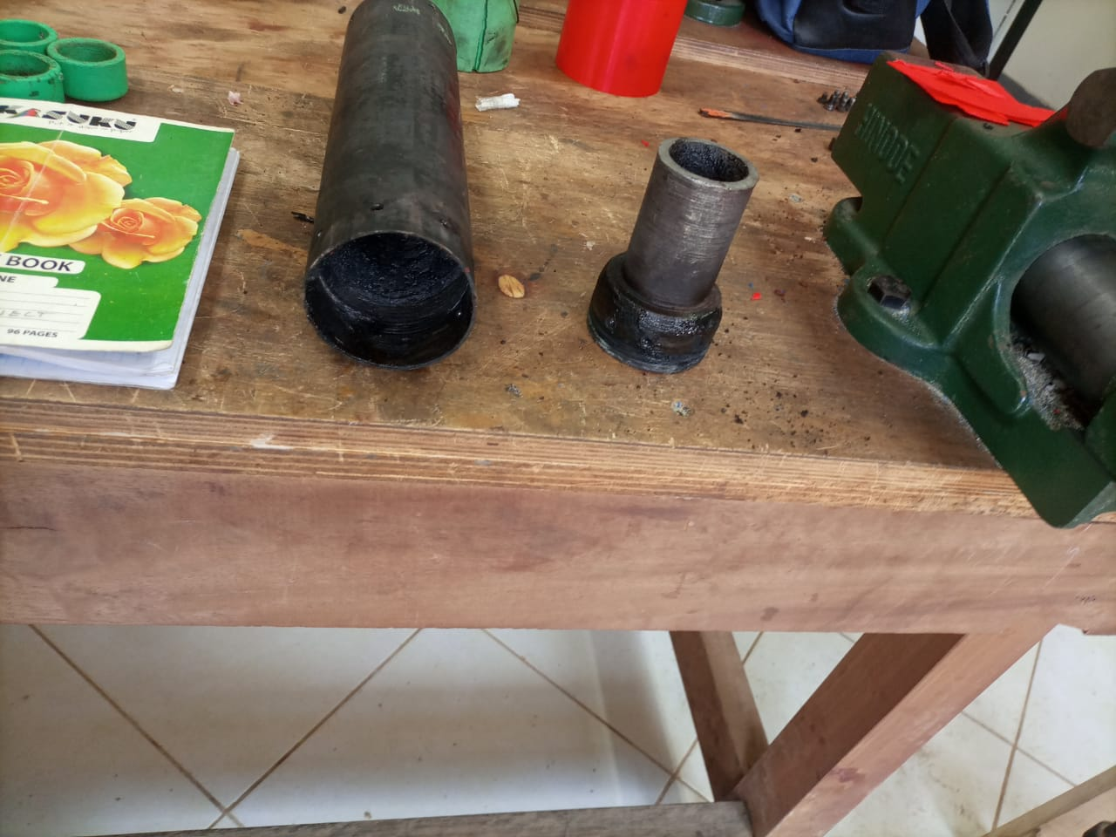
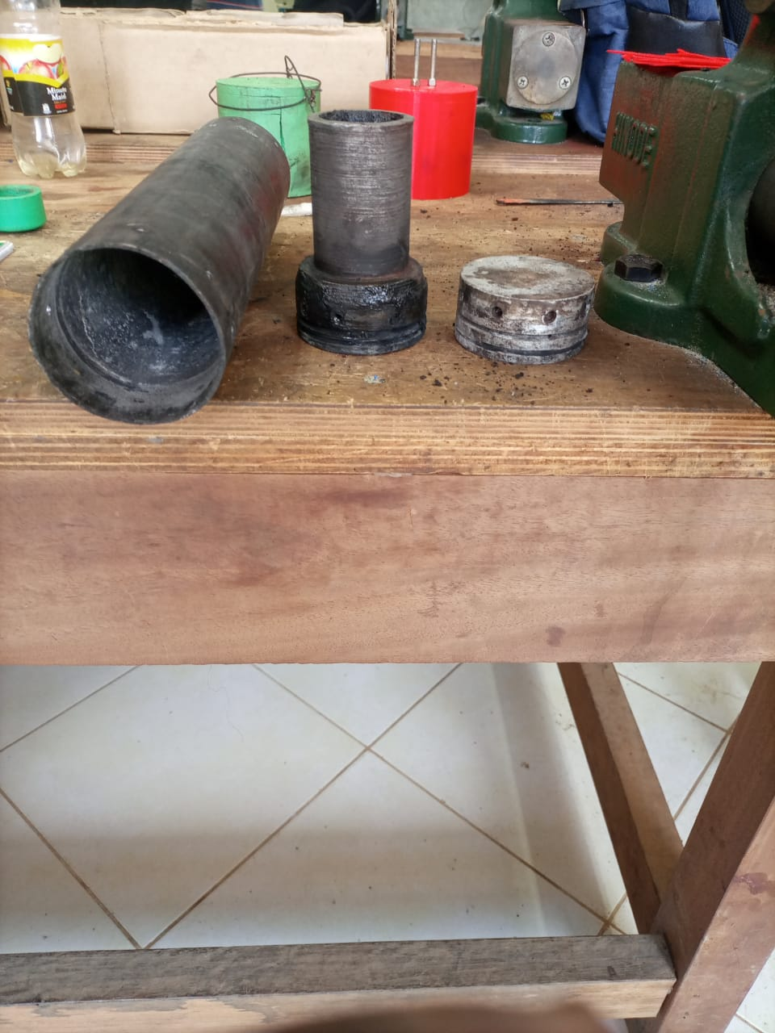
TAKING APART THE 2 GRAIN MOTOR.
O’RING FAILURE.

Slide 4
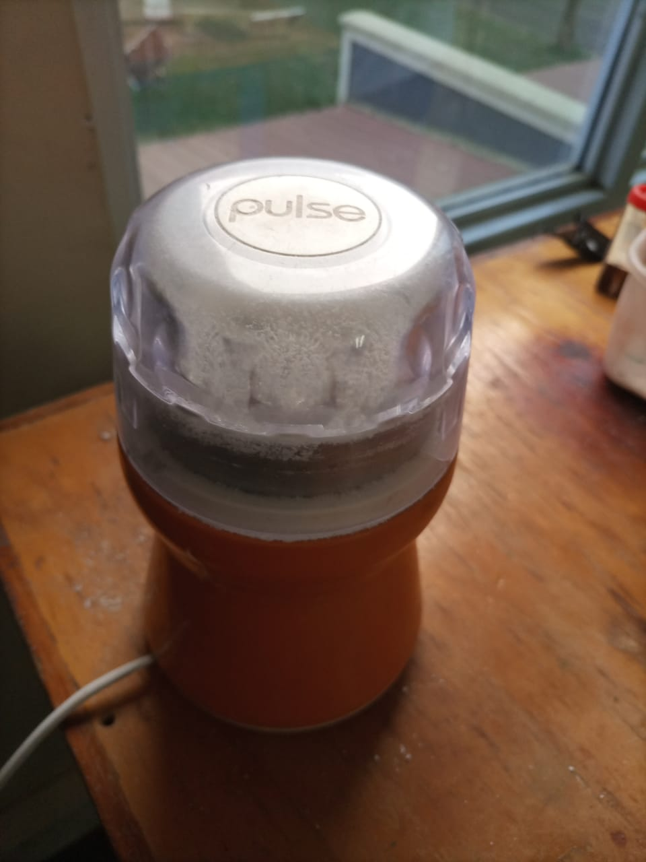
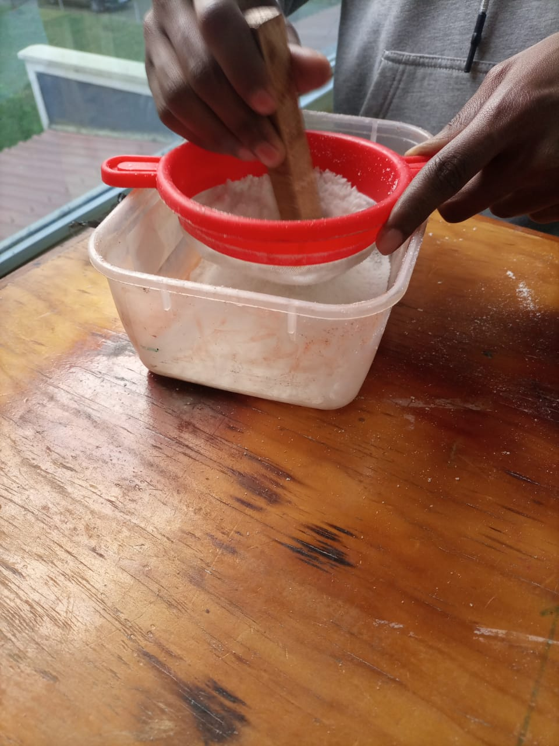
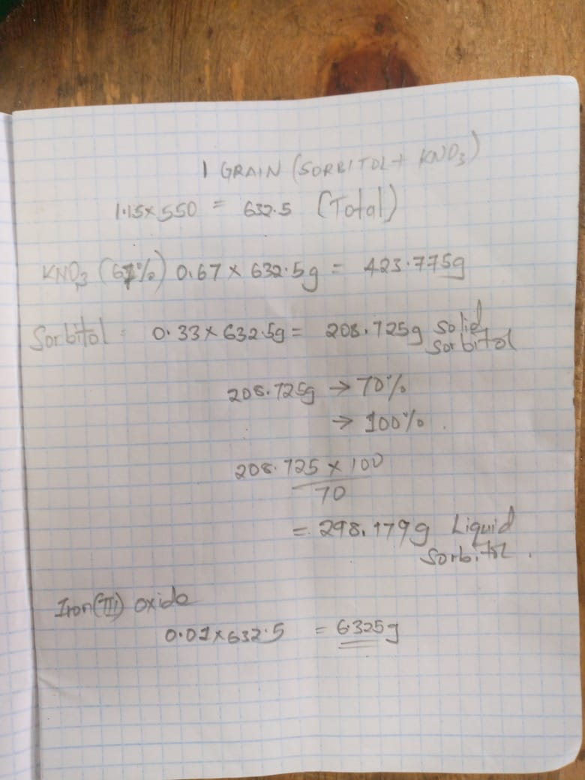
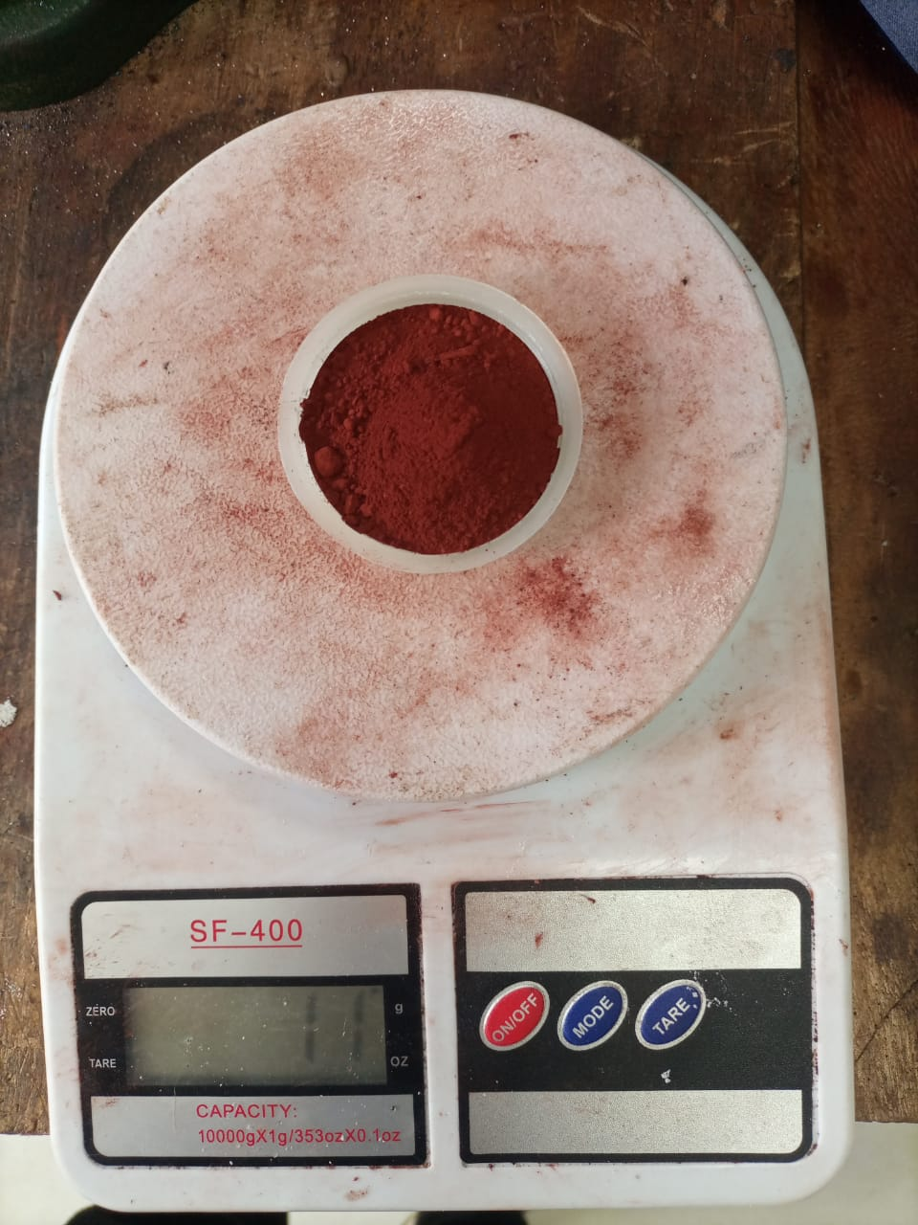
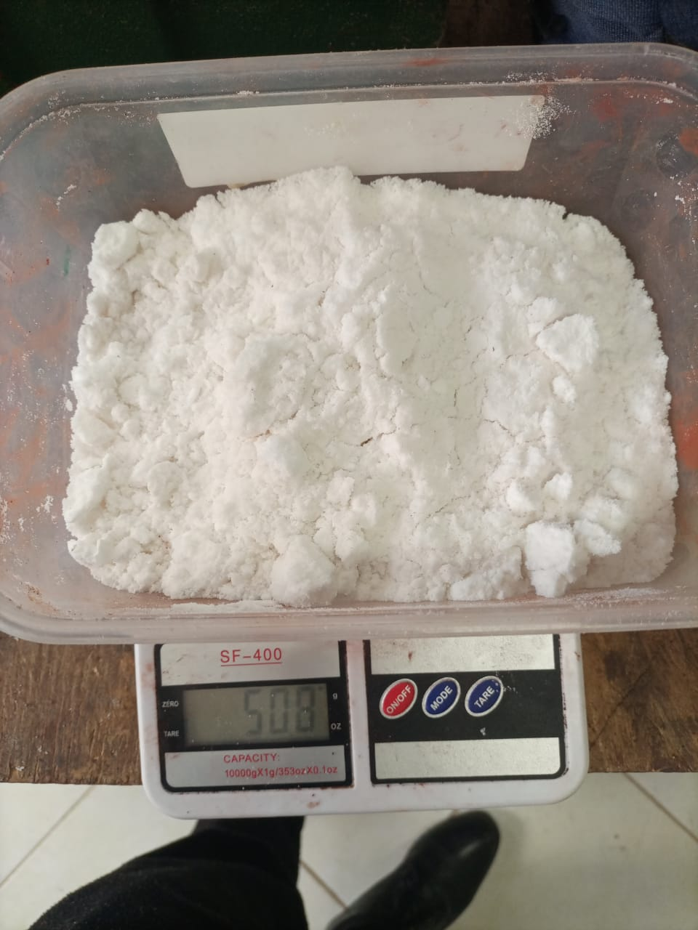
COOKING THREE GRAINS.
KNSB propellant;
oxidizer-fuel (O:F) ratio of 67:33
We added 1% iron(iii)oxide of the total mass.

Slide 5
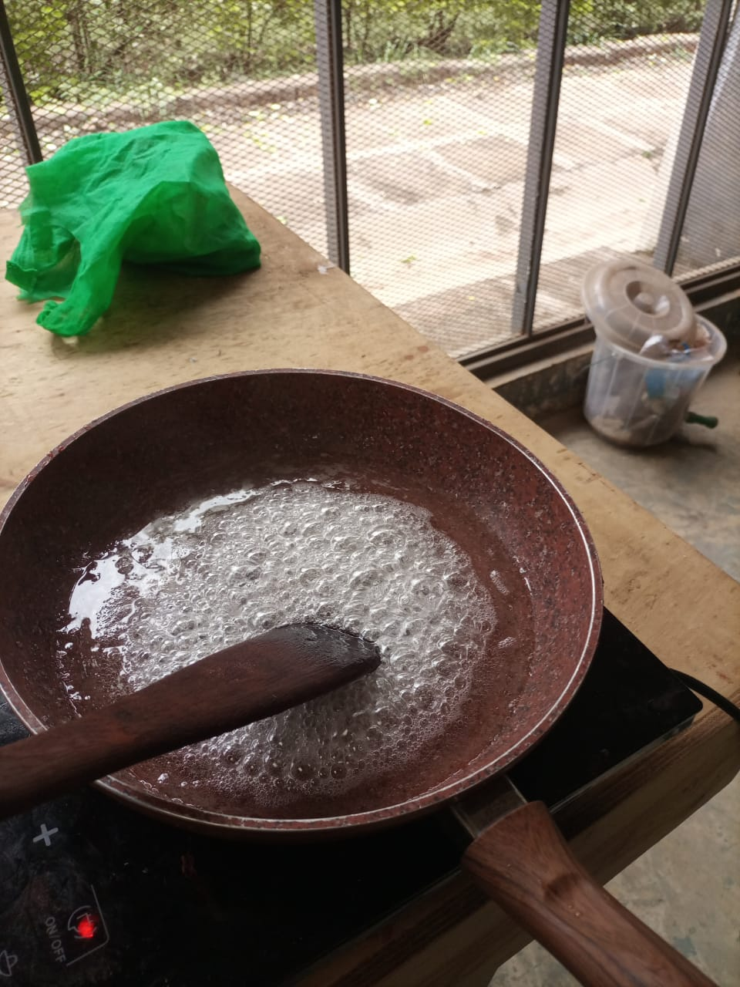
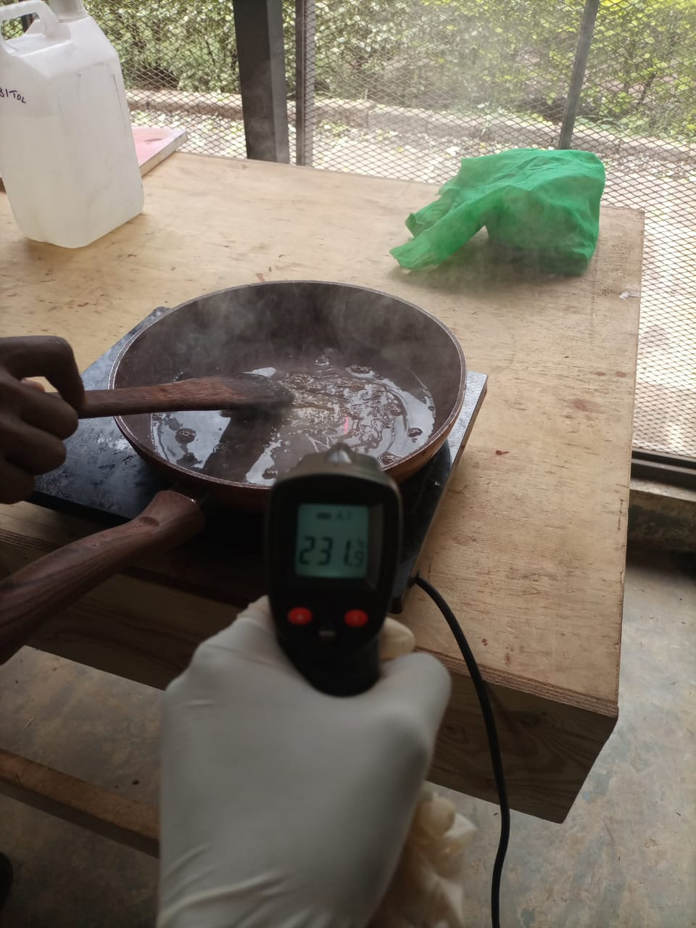
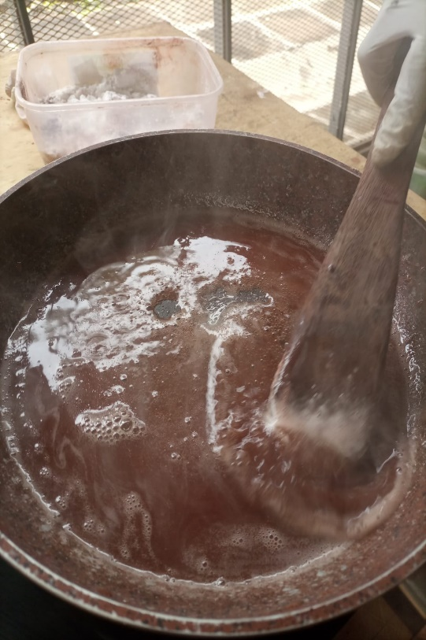
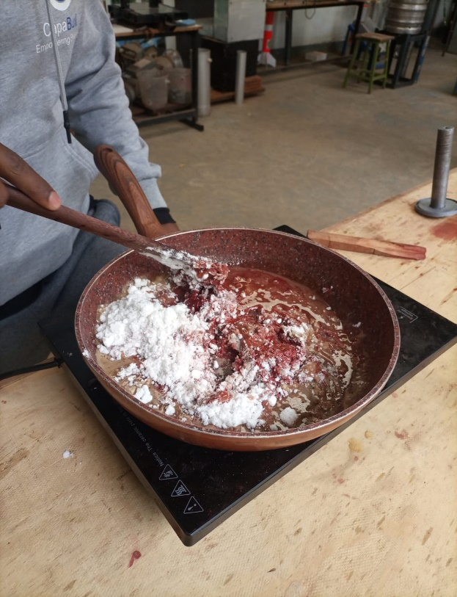
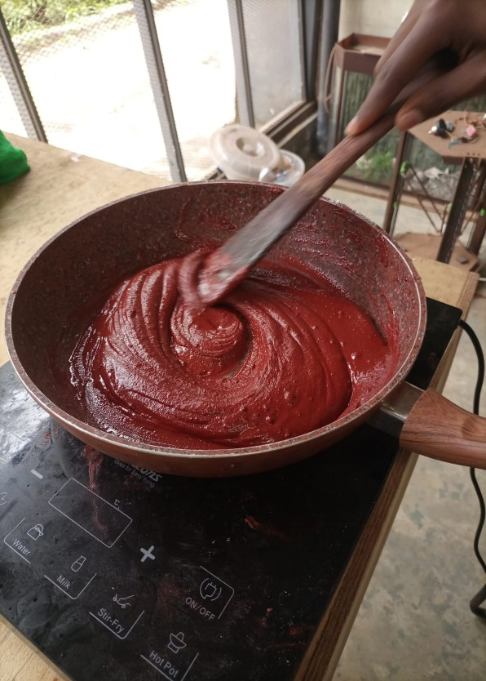
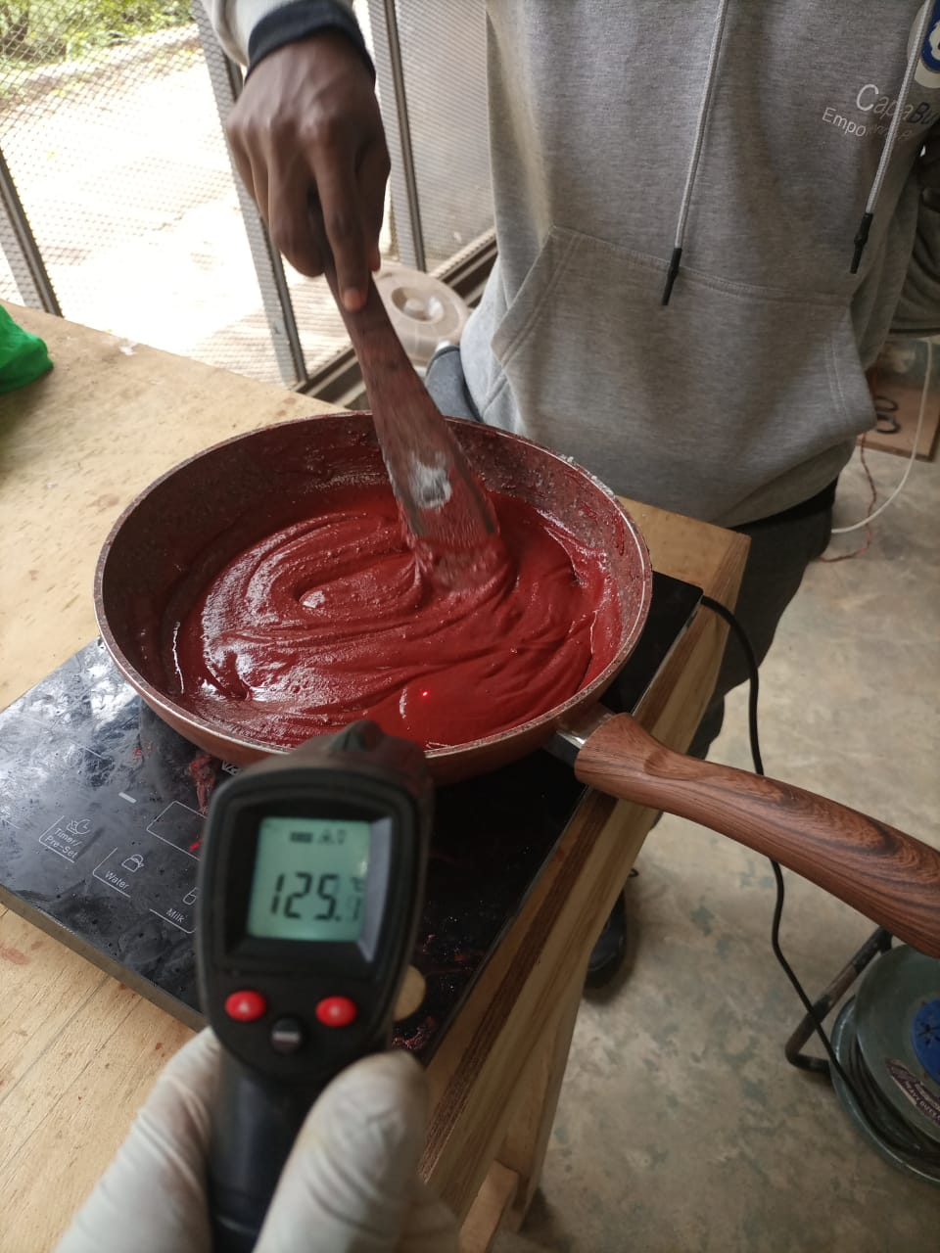
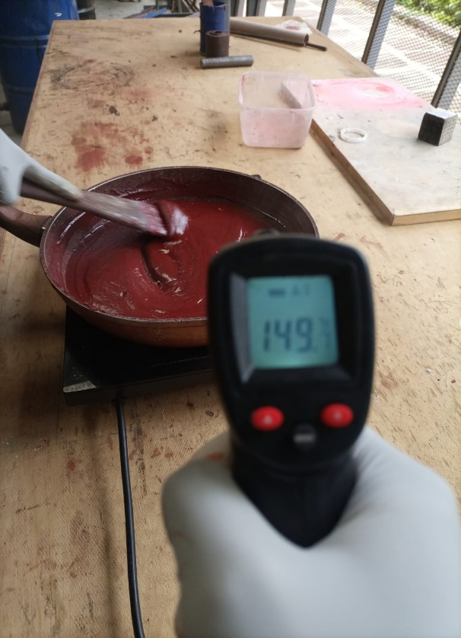
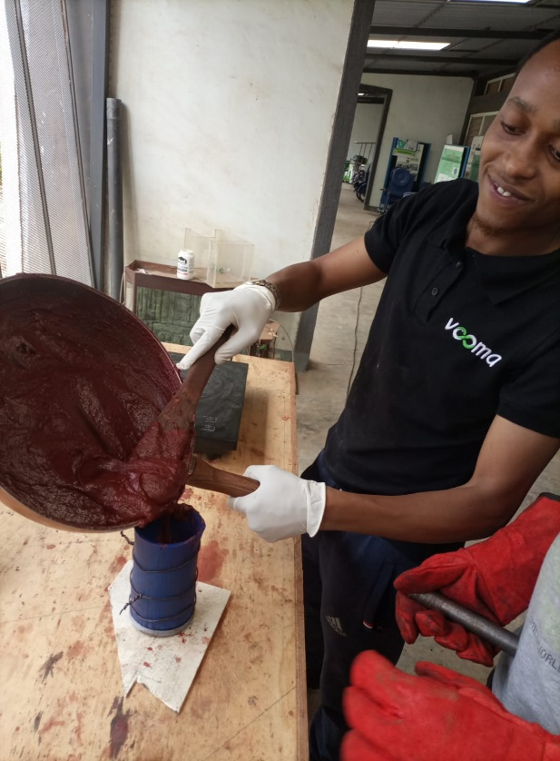
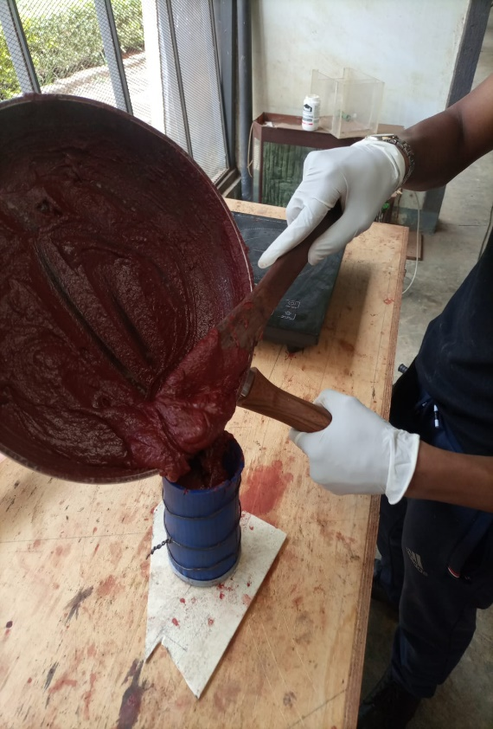

Slide 6
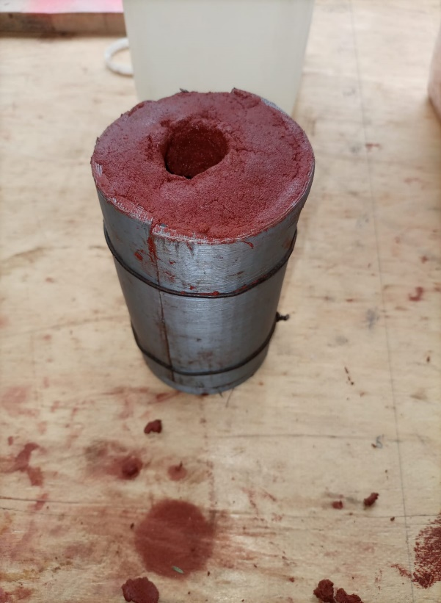
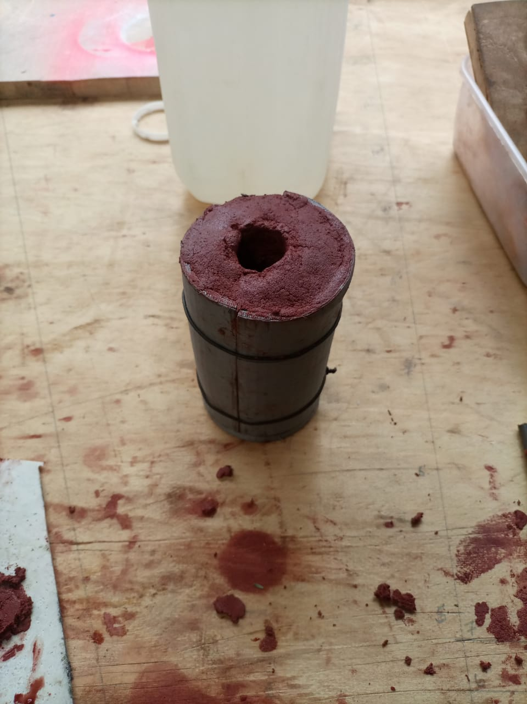
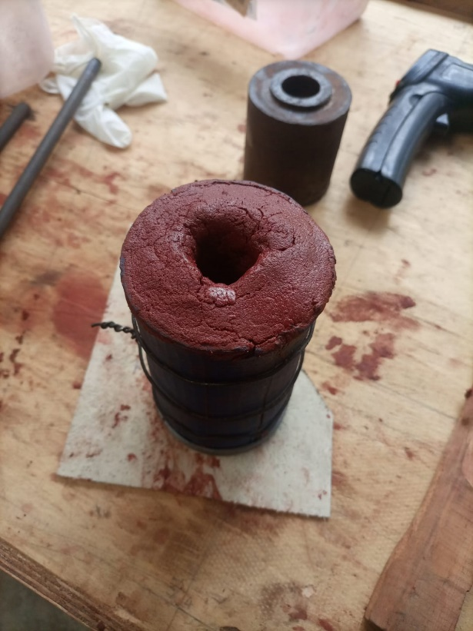
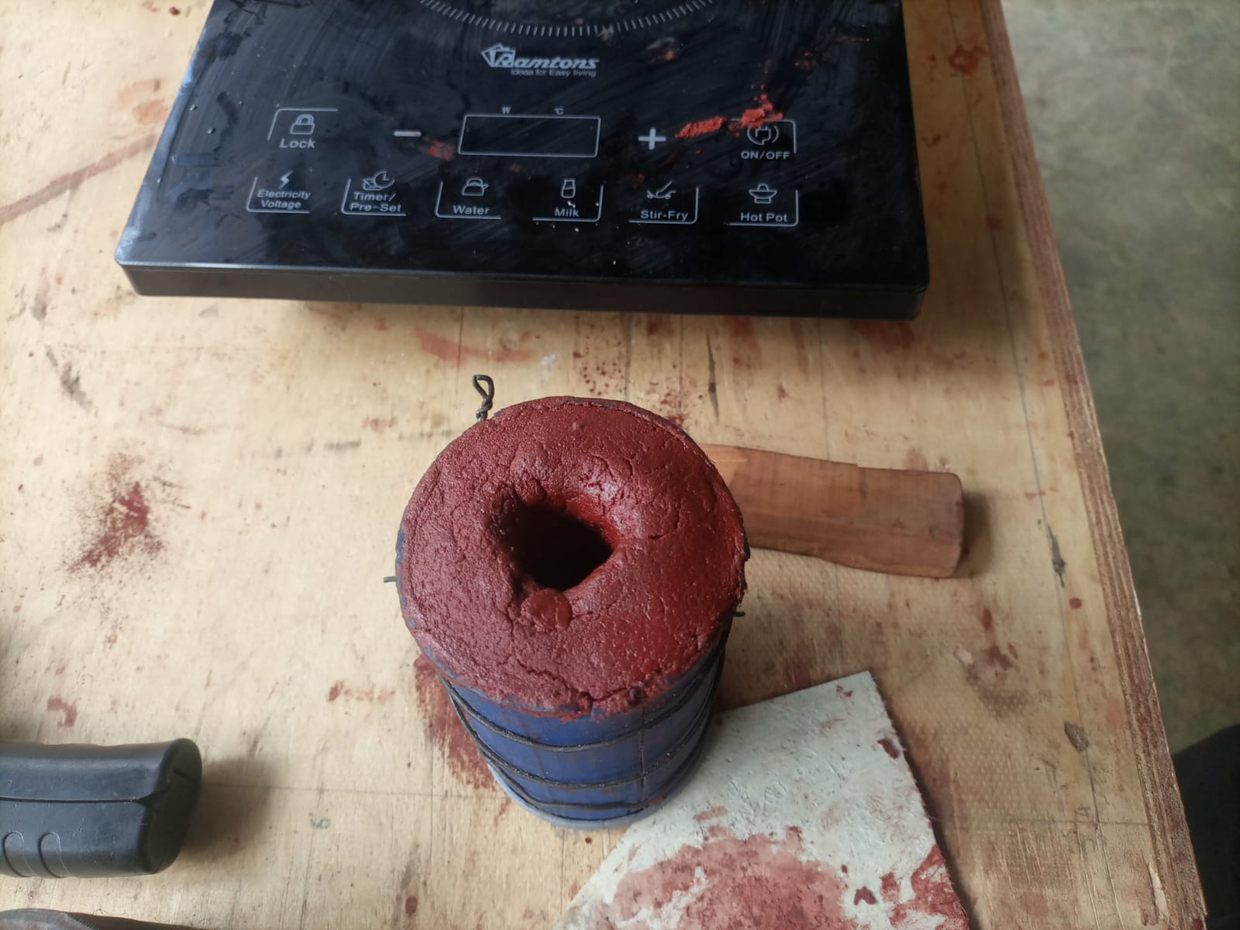
RESULT.
GRAIN 1
GRAIN 2
GRAIN 3

Slide 7
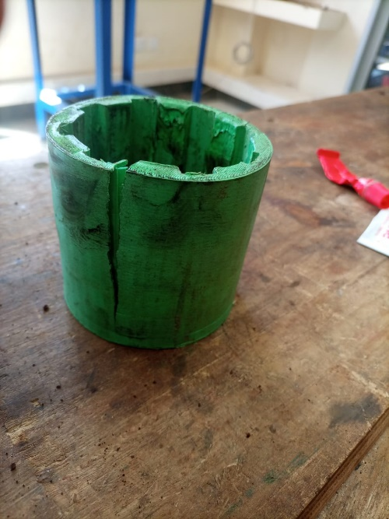
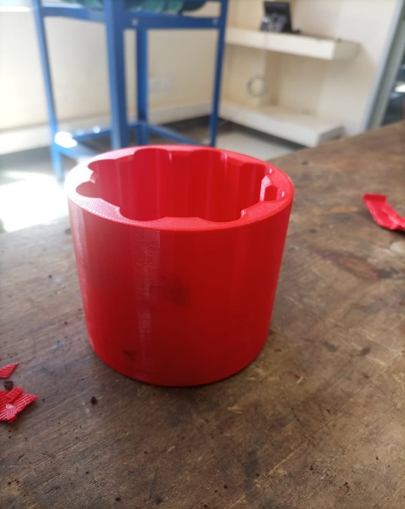
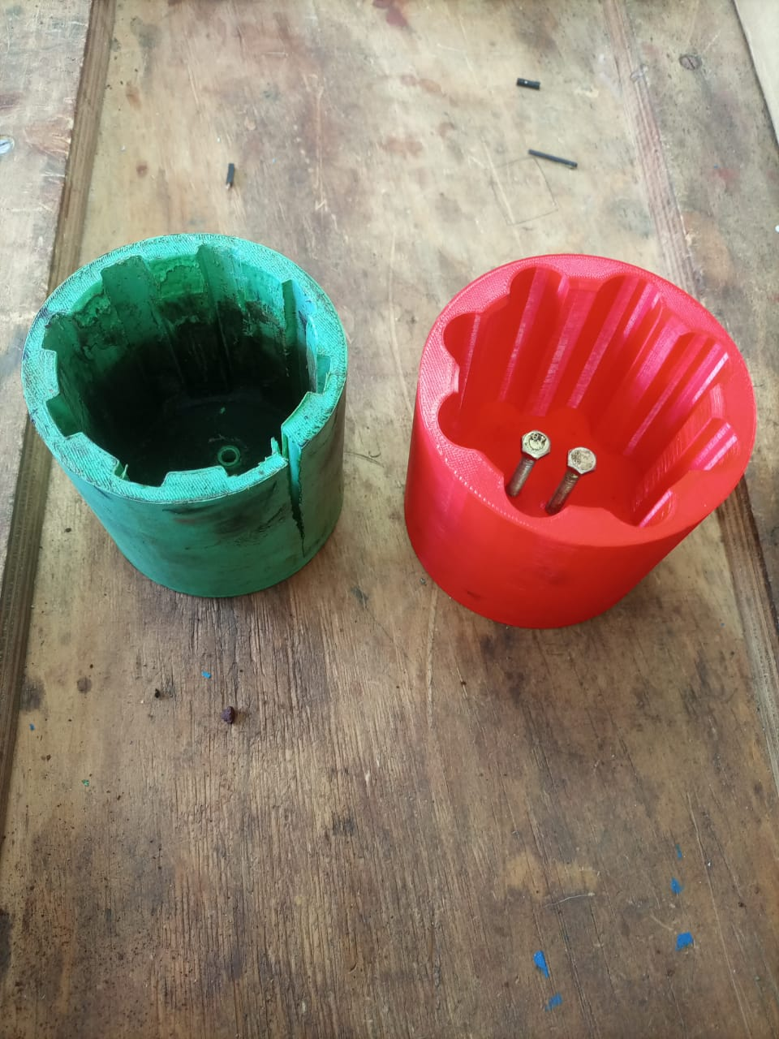
3D PRINT MOTOR HOLDER.
OLD MODEL.
NEW MODEL.

Slide 8
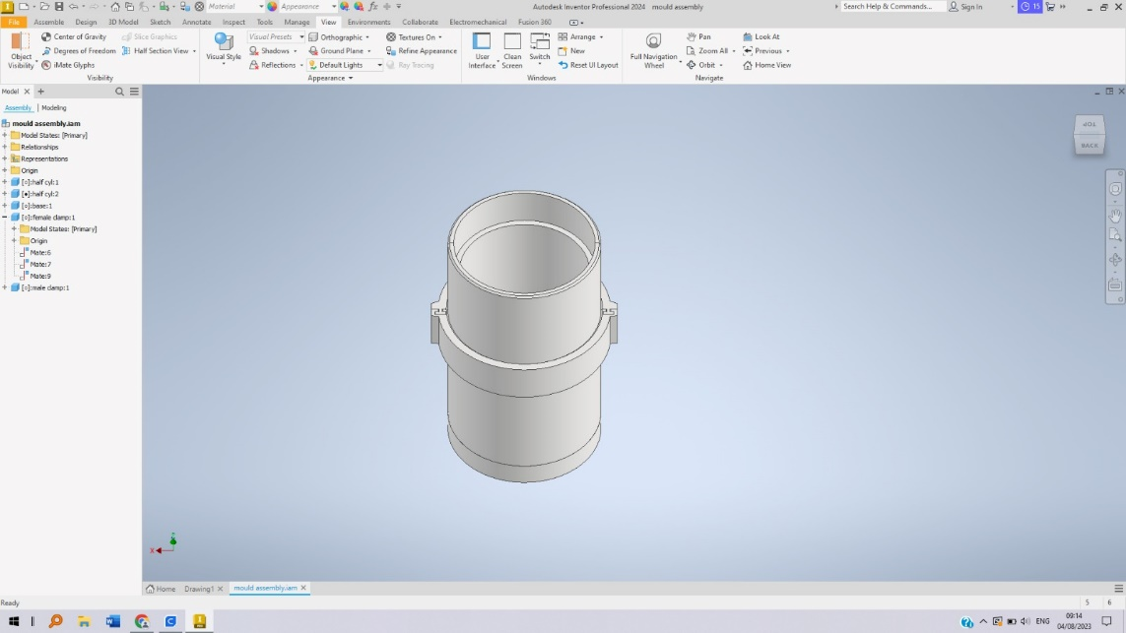
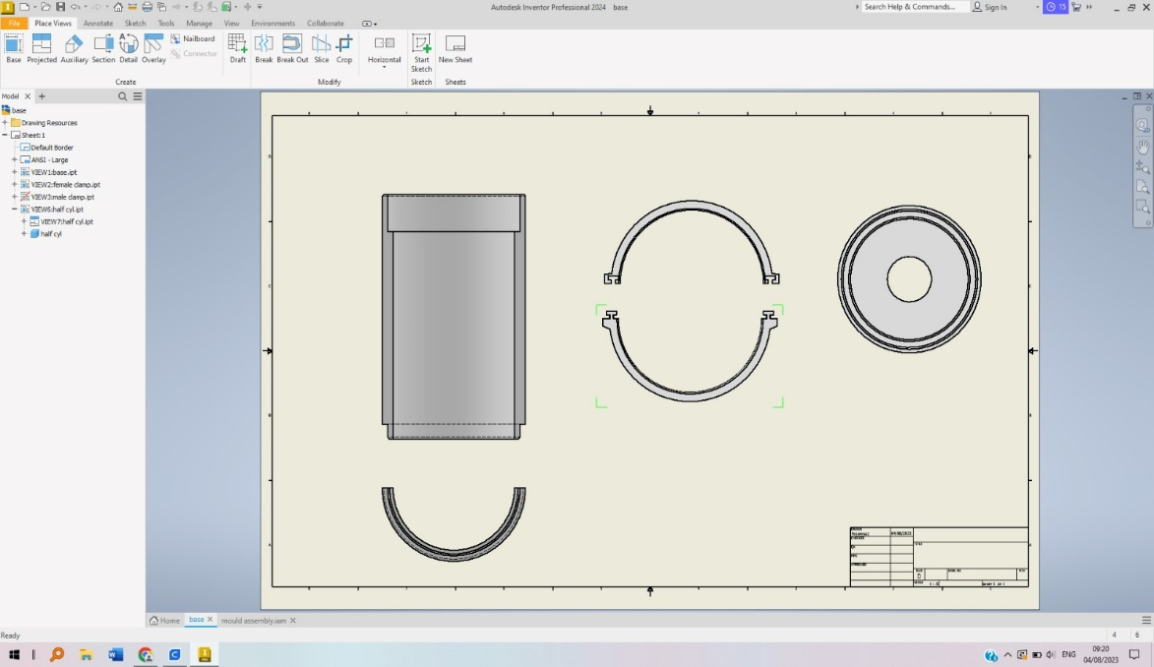
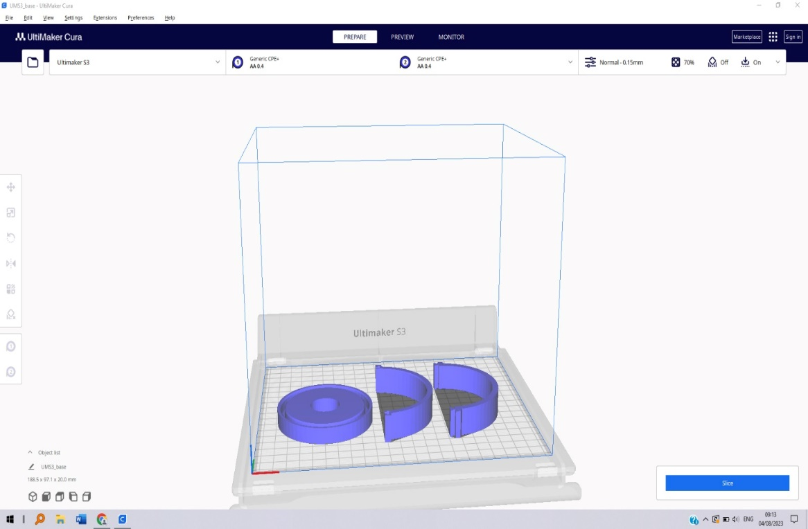
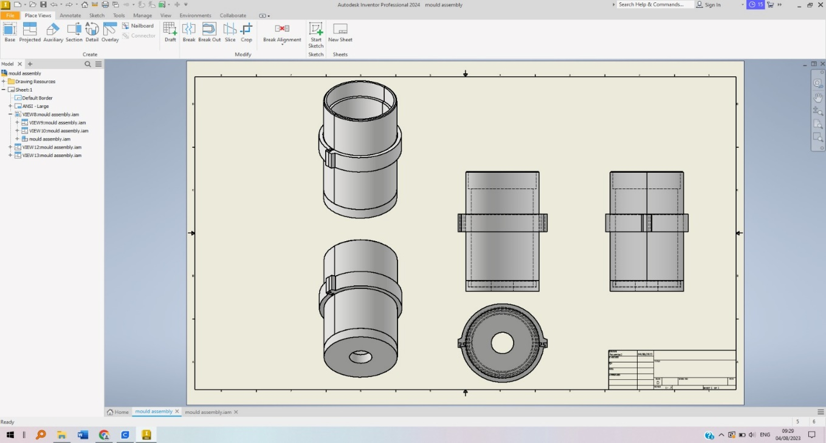
DESIGN & 3D PRINT CASTING TOOLS.
PRINTING YET TO BE DONE.

Slide 9
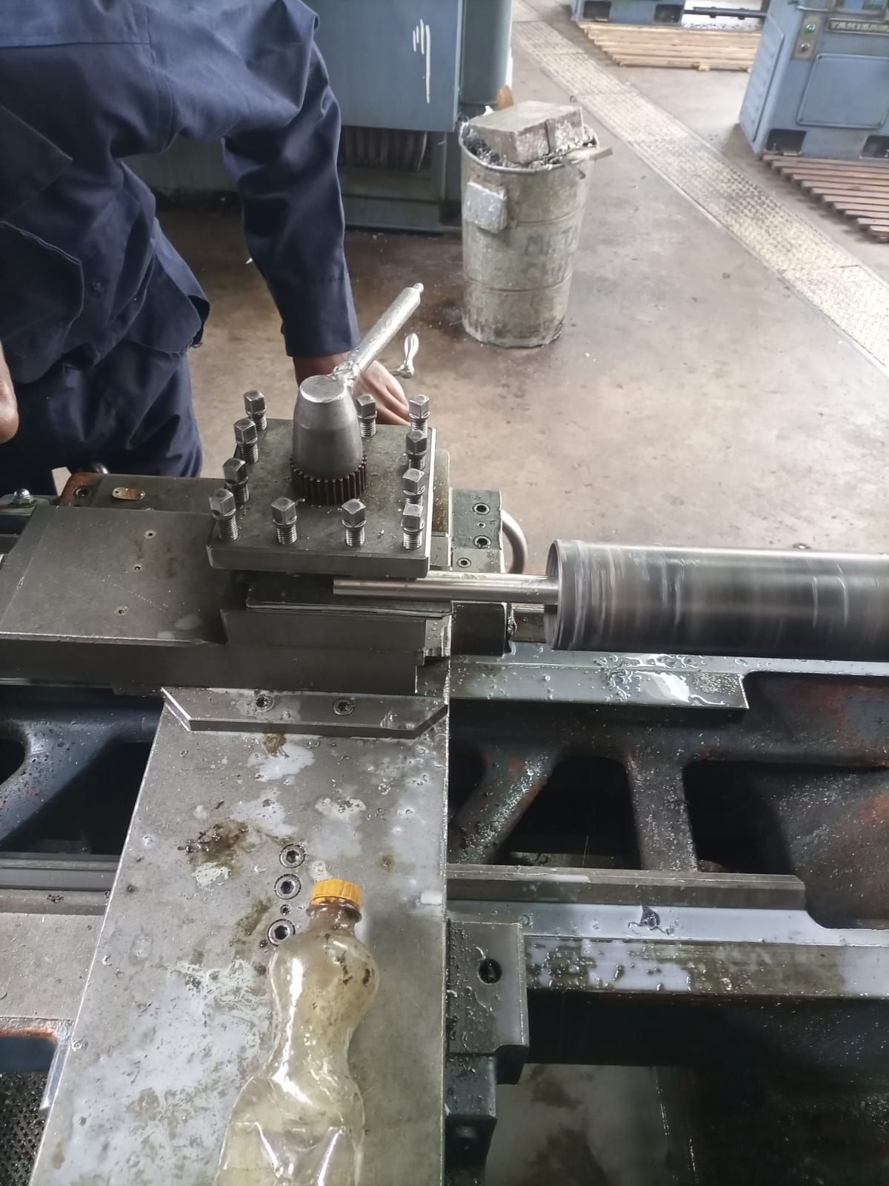
MACHINING THE 1ST THREE GRAIN CASING.

Slide 10
CUT PIPE FOR SECOND THREE GRAIN CASING.
To be done today.

Slide 11
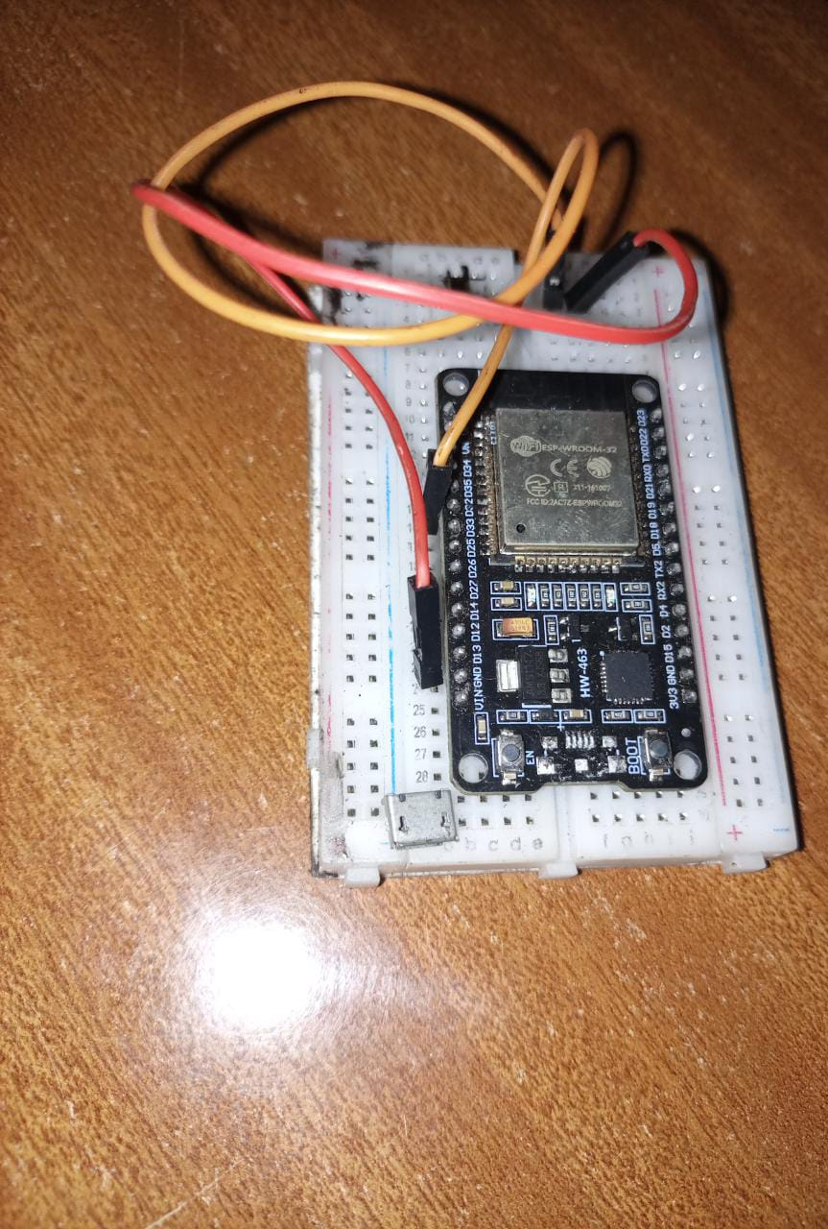
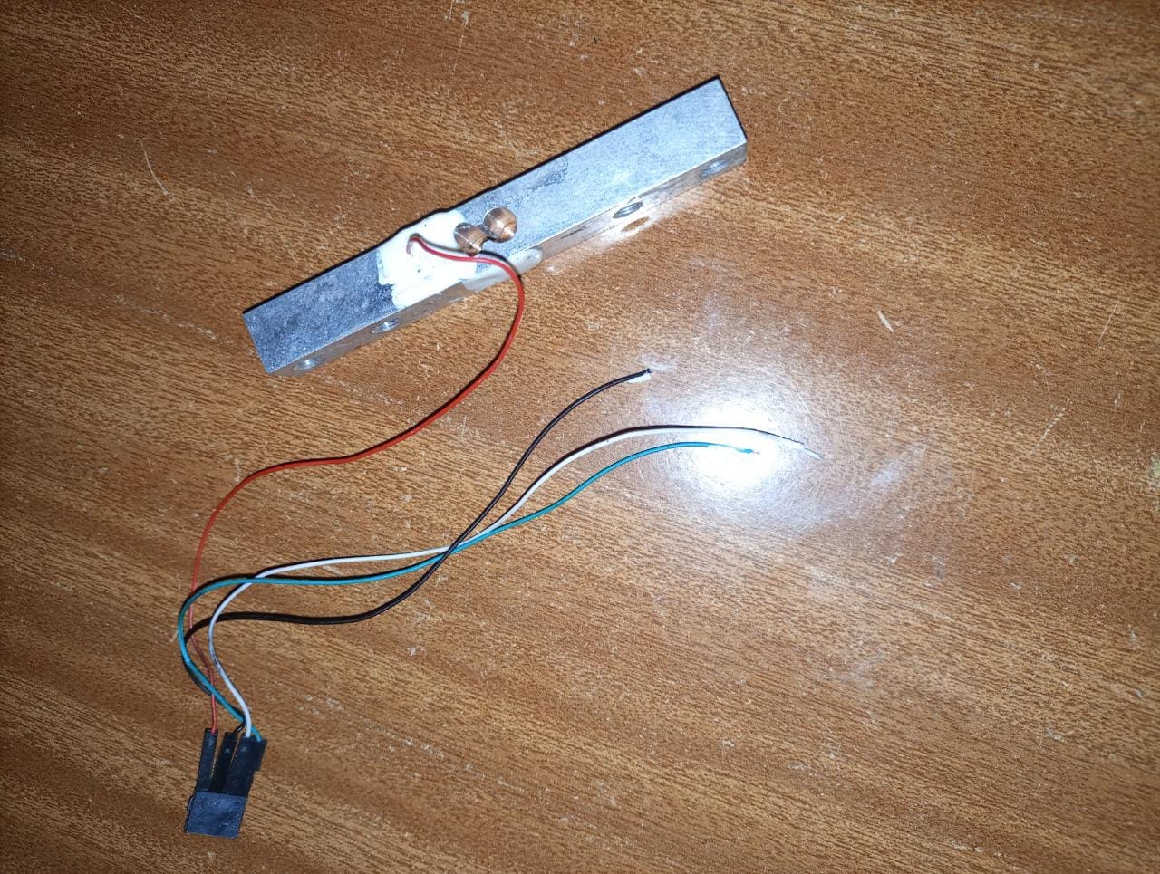
Challenges.
ESP FAILURE
LOADCELL FAILURE

Slide 12

NEXT WEEK’S OBJECTIVES.
FINISH MACHINING THE 1st THREE GRAIN CASING.
START MACHINING THE 2nd THREE GRAIN CASING.
COOK THREE GRAINS
3D PRINT CASTING TOOLS
PREPARE 1ST THREE GRAIN MOTOR FOR STATIC TEST.
PROCURE 500 KG LOADCELL FOR STATIC TEST.

Slide 13
THANK YOU

